Slide 1
Powered by Agartheum
www.agarthea.org

Slide 2
Agenda
2
Presentation is scheduled for 45 minutes with a 15-minute period thereafter for questions.
Introduction
What is Agarthea
What is Agartheum
How does it all work
Product
Investor Relations
Problems & Solutions
Competitors
Agartheum
Roadmap
USPs
Partnerships
Founders Statement
Conclusions
How we help :
Market Cap &
Target Market
Mission & Goals
Students
Universities
Businesses
Everyone
Questions & FAQ

Slide 3
“Education is the most powerful weapon which you can use to change the world.”
- Nelson Mandela -

Slide 4
Agarthea
4
An Environmental, Social, and Corporate Governance (ESG) focused nonprofit Decentralised Autonomous Organisation (DAO). Built by the people, for people to provide a diverse range of options for Work and Further Education for Students & Professionals around the World in a cost-effective/costless and eco-friendly manner
Agartheum
The crypto token that is built on Polygon blockchain that will be used on Agarthea to support the monetary functions and transactions, including to fund the education for students across the globe.

Slide 5
Problems
5
Solutions
Silo Products & Services
Limited Locations & Programs
3rd Party Data Sharing
No Tracking System
Free education
Worldwide access
Integrated services
Little to No Financial Services
No end to end providers
AI & Machine learning
Scholarships & Loan Pool
Data privacy
Earn money
Peer-to-peer
Limited Quota & No Time Flexibility
Transparent process
Web3 wallet integration
24/7 Consultation & Support
Progress tracking system
Decentralized
DAO

Slide 6
We believe the best education should be accessible to every individual around the world, no matter what their background, financial status or circumstances may be
- Agarthea Founders -

Slide 7
How does it all work?
7
Revenue Model
Recruitment Fees
Donations
Listing Fees
Grants
Agartheum
Venture Capital
Tokenomics
Investments
Sponsorships

Slide 8
How does it all work?
7
Revenue Model
Recruitment Fees
Donations
Listing Fees
Grants
Agarthea may charge ( %) to Universities and Institutions as a recruitment fee.
Agartheum
Venture Capital
Tokenomics
Investments
Sponsorships

Slide 9
How does it all work?
7
Revenue Model
Recruitment Fees
Donations
Listing Fees
Grants
Agarthea accept donation from people who wants to help grow the Agarthea ecosystem
Agartheum
Venture Capital
Tokenomics
Investments
Sponsorships

Slide 10
How does it all work?
7
Revenue Model
Recruitment Fees
Donations
Listing Fees
Grants
Agarthea will take grants and the fund received will be used to develop Agarthea ecosystem
Agartheum
Venture Capital
Tokenomics
Investments
Sponsorships

Slide 11
How does it all work?
7
Revenue Model
Recruitment Fees
Donations
Listing Fees
Grants
Agarthea will raise funds from VC and all the raised funds will be given back to Agarthea users
Agartheum
Venture Capital
Tokenomics
Investments
Sponsorships

Slide 12
How does it all work?
7
Revenue Model
Recruitment Fees
Donations
Listing Fees
Grants
Investors who invest in Agarthea, will help Agarthea to develop and grow the ecosystem
Agartheum
Venture Capital
Tokenomics
Investments
Sponsorships

Slide 13
How does it all work?
7
Revenue Model
Recruitment Fees
Donations
Listing Fees
Grants
Agarthea has sponsorships relation. All the sponsorships fund will be given back to our users to help students
Agartheum
Venture Capital
Tokenomics
Investments
Sponsorships

Slide 14
How does it all work?
7
Revenue Model
Recruitment Fees
Donations
Listing Fees
Grants
Agartheum tokenomics allow us to get a share of funds that can be used to fund Agarthea projects
Agartheum
Venture Capital
Tokenomics
Investments
Sponsorships

Slide 15
How does it all work?
7
Revenue Model
Recruitment Fees
Donations
Listing Fees
Grants
Agarthea use Agartheum to support on the ecosystem and the profit from Agartheum we hold, will be used to maintain and develop Agarthea further
Agartheum
Venture Capital
Tokenomics
Investments
Sponsorships

Slide 16
How does it all work?
7
Revenue Model
Recruitment Fees
Donations
Listing Fees
Grants
Agarthea will select trusted and innovative programs/projects submitted by project creators to be run on Agarthea platform.
Agartheum
Venture Capital
Tokenomics
Investments
Sponsorships

Slide 17
How does it all work?
8
Agarthea is a nonprofit DAO, meaning ALL profits made will be placed back into Agarthea and/or Agartheum Eco-Systems focusing on funding students who lack the financial means. This includes all or some of the following; Funding, Tuition Fees, Travel, Visas, Food, Activities, Equipment, Accommodation, Grants, Loans, etc.

Slide 18
Competitors
9
Decentralized (peer-to-peer)
Search University
Consultation
Scholarships / Financial Aid
Visa Service
Activities (including esports & gaming)
Integration
Job Portal
E-Learning
Accommodation
FinTech Service
Transportation
Agarthea
CIEE
IDP
IES Abroad
Unimy
Feenix
Uniathena
Studyum
Tutellus
Ledu

Slide 19
USP
10

Slide 20
How we help :

Slide 21
Everyone Else
12
Student
Businesses
Go to A-Z Use Cases
University

Slide 22
Everyone Else
12
Student
Businesses
Students find and apply to university anywhere in the world.
Go to A-Z Use Cases
University

Slide 23
Everyone Else
12
Student
Businesses
Universities provide online courses, e-learning, e-books, e-journals, or e-library for students
Go to A-Z Use Cases
University

Slide 24
Everyone Else
12
Public can search and book flight through Agarthea and be able to track all the status on the platform
Student
Businesses
Go to A-Z Use Cases
University

Slide 25
Everyone Else
12
Public – Apply for visa for their travel
Students – Apply visa to study abroad
Businesses – Provide service for Visa application
Student
Businesses
Go to A-Z Use Cases
University

Slide 26
Everyone Else
12
Public & Students – Book or buy public transport ticket
Businesses – Provide service for public transport
Student
Businesses
Go to A-Z Use Cases
University

Slide 27
Everyone Else
12
Public & Students – Find and join on public activities or communities or tournament
Businesses – Provide places or services for public activities places such as fitness center, activities center, game center, etc
Student
Businesses
Go to A-Z Use Cases
University

Slide 28
Everyone Else
Public – Book accommodation for their travel
Students – Find dorm, or book other type accommodation for their study abroad
Businesses – Provide places for accommodation
12
Student
Businesses
Go to A-Z Use Cases
University

Slide 29
Everyone Else
12
Public – Contribute to help students by providing scholarships (solo) through Agarthea Scholarship Pool
Student – Apply for scholarships to fund their education
University – Provide scholarships for students who study on their university
Businesses – Provide corporate scholarship for students to study.
Student
Businesses
Go to A-Z Use Cases
University

Slide 30
Everyone Else
12
Public, Students, University, Businesses – Everyone can create Agarthea wallet to store their assets for payment purpose or making transaction both inside and outside Agarthea.
People can also connect their own Web3 wallet to Agarthea platform
Student
Businesses
Go to A-Z Use Cases
University

Slide 31
Everyone Else
12
Public – Search and apply jobs
Students – Search and apply jobs after their graduated or internship program
Businesses – Provide jobs to people or students
Student
Businesses
Go to A-Z Use Cases
University

Slide 32
Everyone Else
12
Public – Contribute to provide student loan and any other financial aid (solo)
Students – Apply for student loan or other financial aid
Businesses – Provide student loan or financial aid
University – Provide student loan or financial aid for students who study in their university.
Student
Businesses
Go to A-Z Use Cases
University

Slide 33
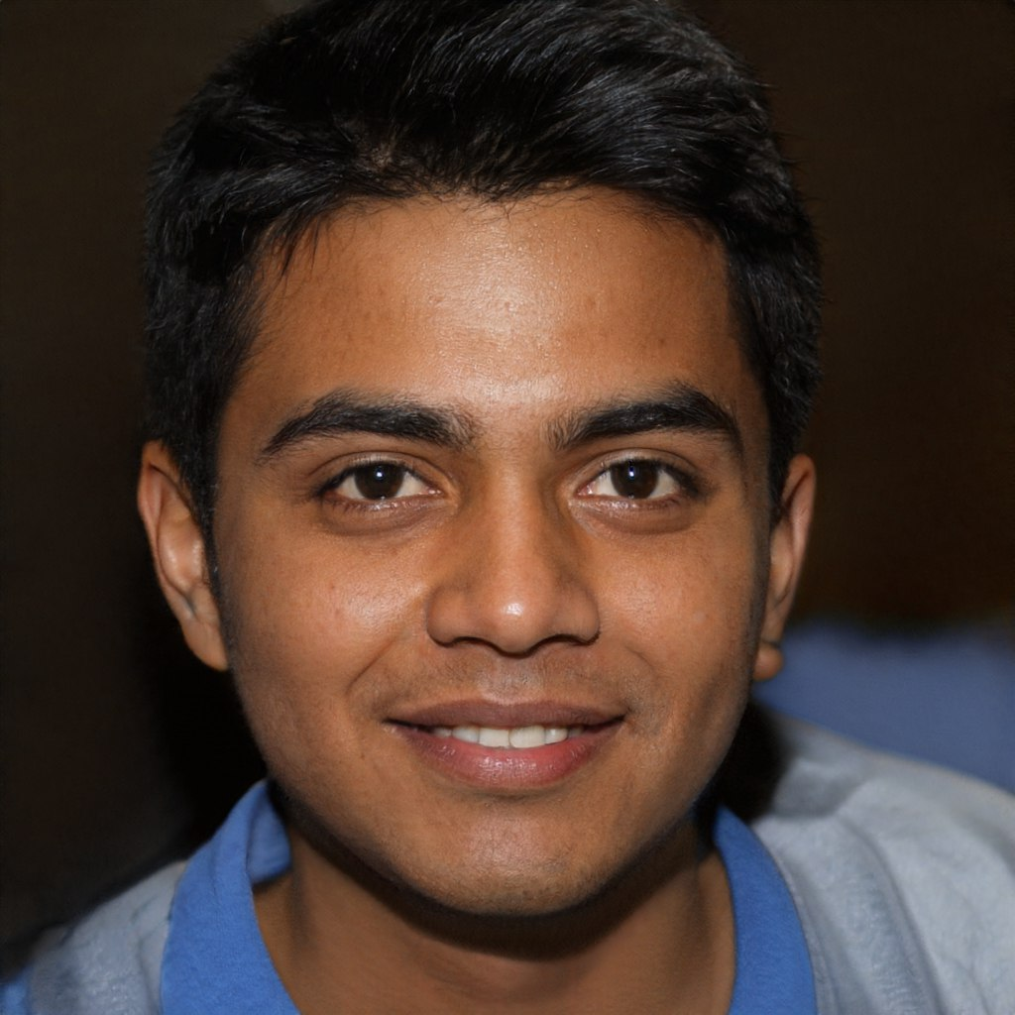
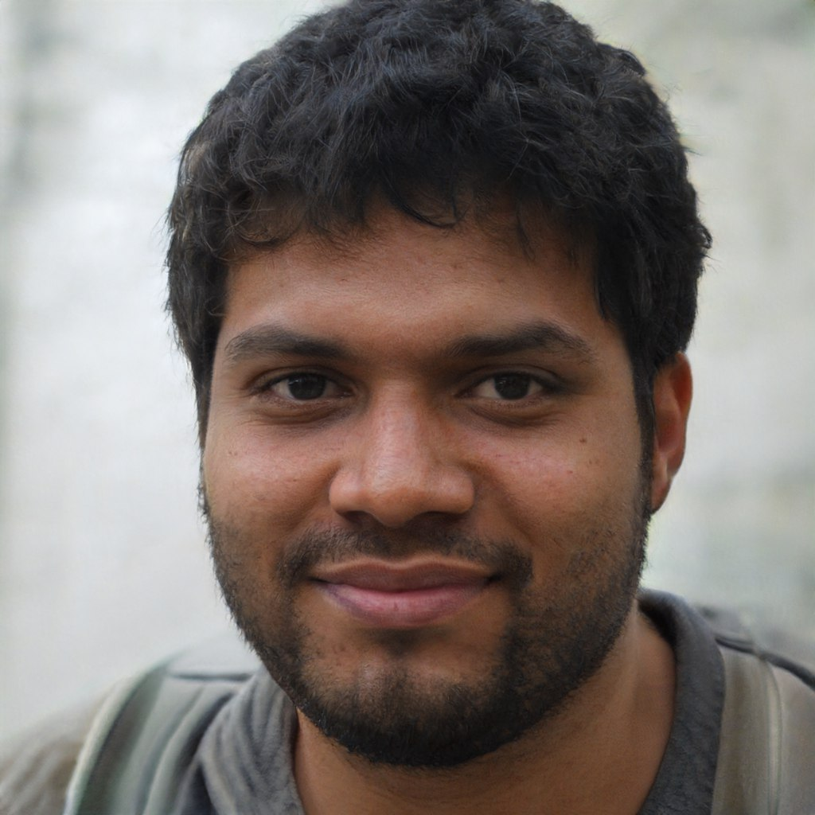
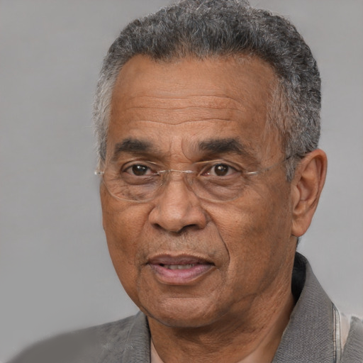
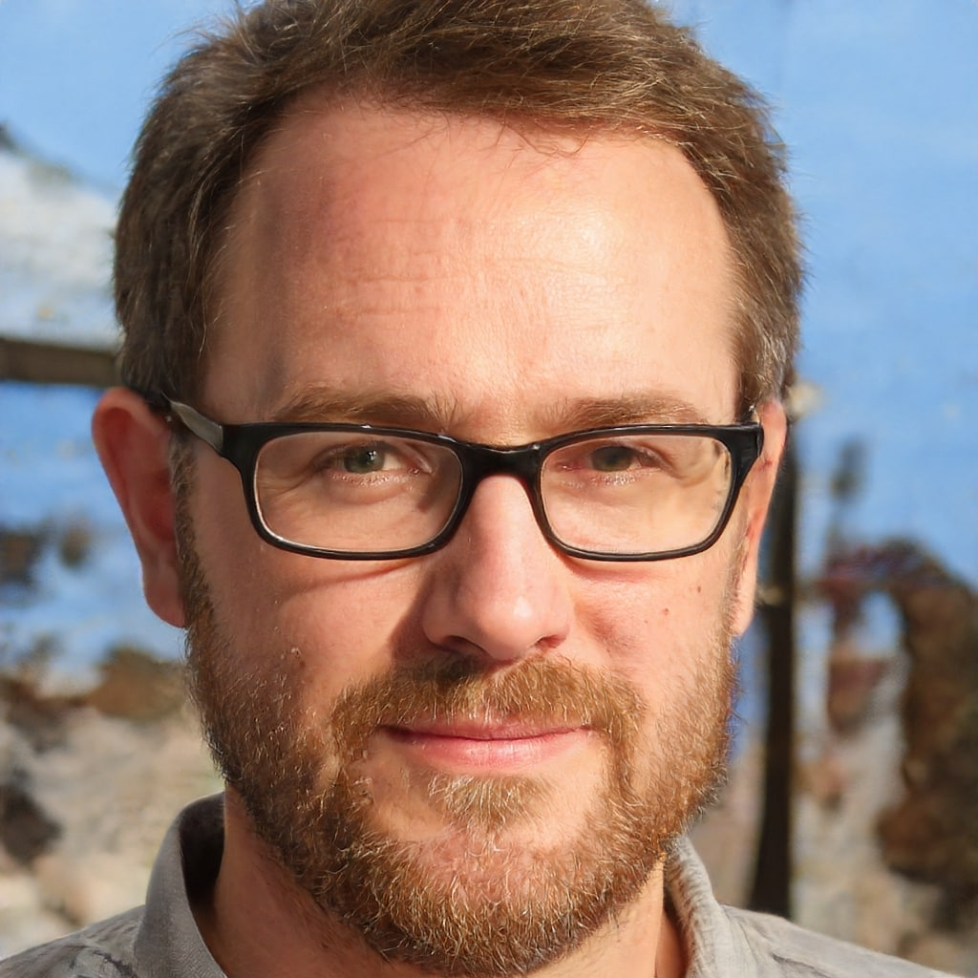
A
B
12
Ahmed, a 16-year-old Afghan boy from a low-middle-income family, wishes to study ATAR accounting in Australia.
He's looking for ATAR scholarships in Agarthea to help fund his studies, and he sees a variety of universities where he can apply.
Bappy is a Bangladesh Blockchain Developer. To advance in his work, he is looking for certification and training.
He applies for certification and studies a variety of Blockchain courses on Agarthea. He now has his first certification and has a better understanding of blockchain.
C
D
Chamath is the President and Chancellor of a university in Cambodia. Chamath wants to grow his business by starting a student exchange program.
He uses Agarthea to enlist more students from outside of Cambodia. Students from other countries flock to his university in large numbers because of its wide range of courses.
Daniel is a Director of Hotel Operations in Denmark. He must travel frequently because of the nature of his job. He must now take cheap flight on each work trip because the company just slashed the budget for business travel. Additionally, he frequently loses track of his bookings due to his busy schedule.
His job has become less hectic after he learned about Agarthea because he can easily find affordable tickets and handle all of his bookings in one location.

Slide 34
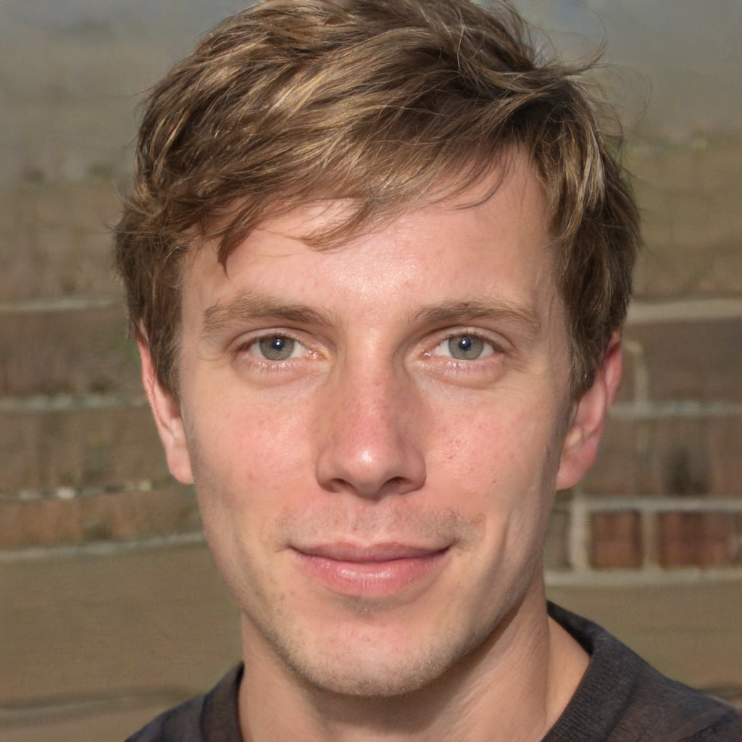
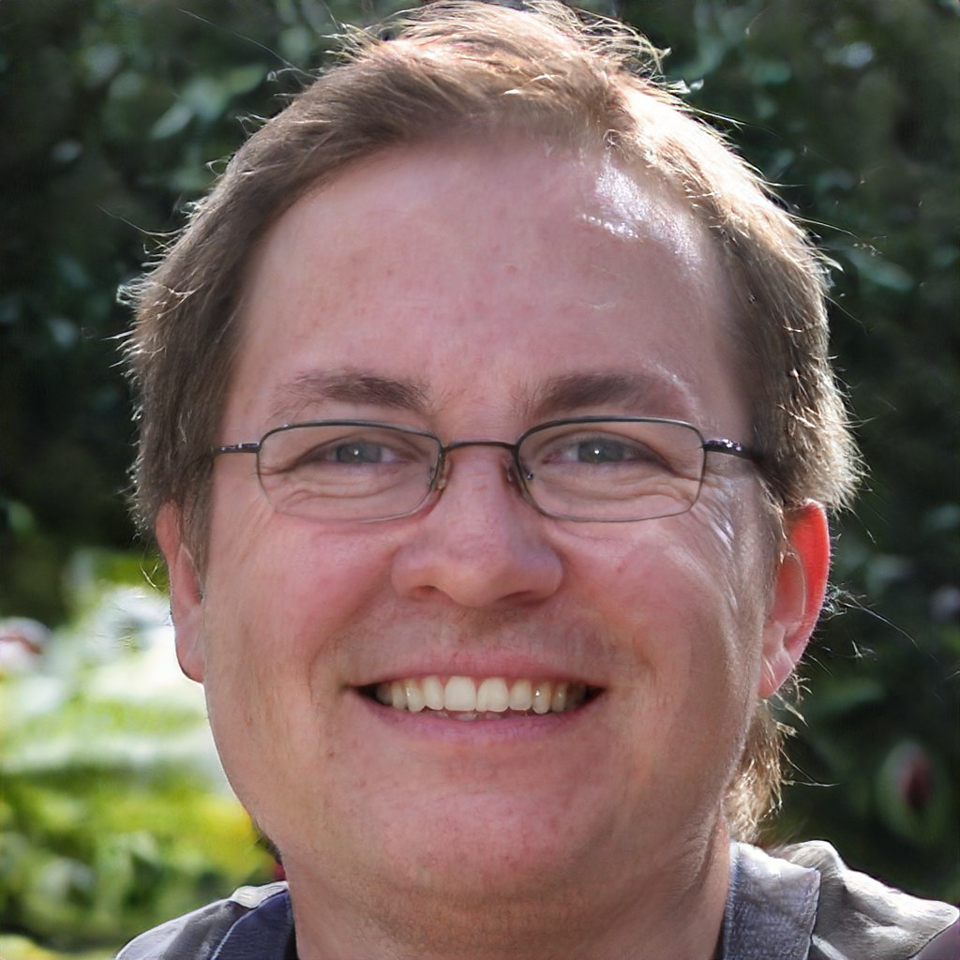
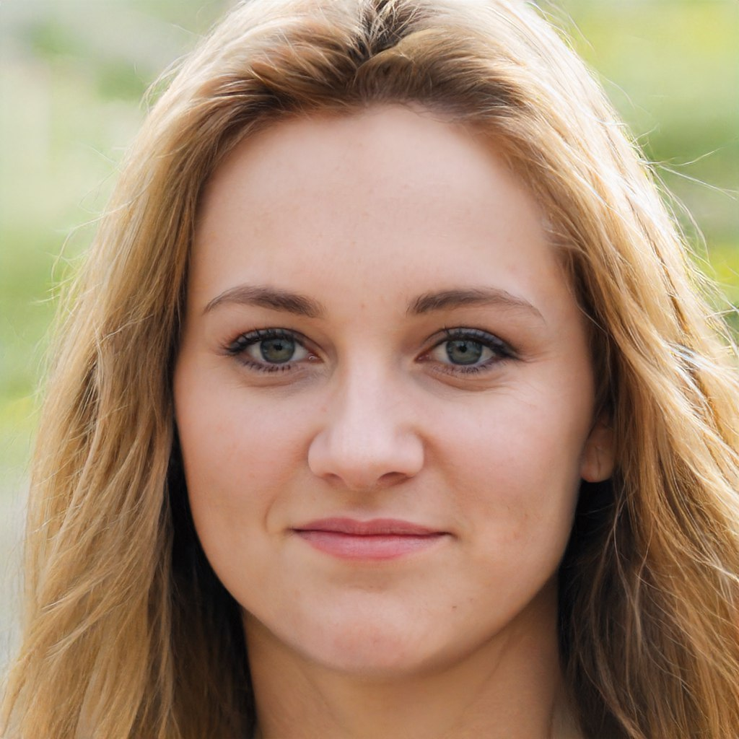
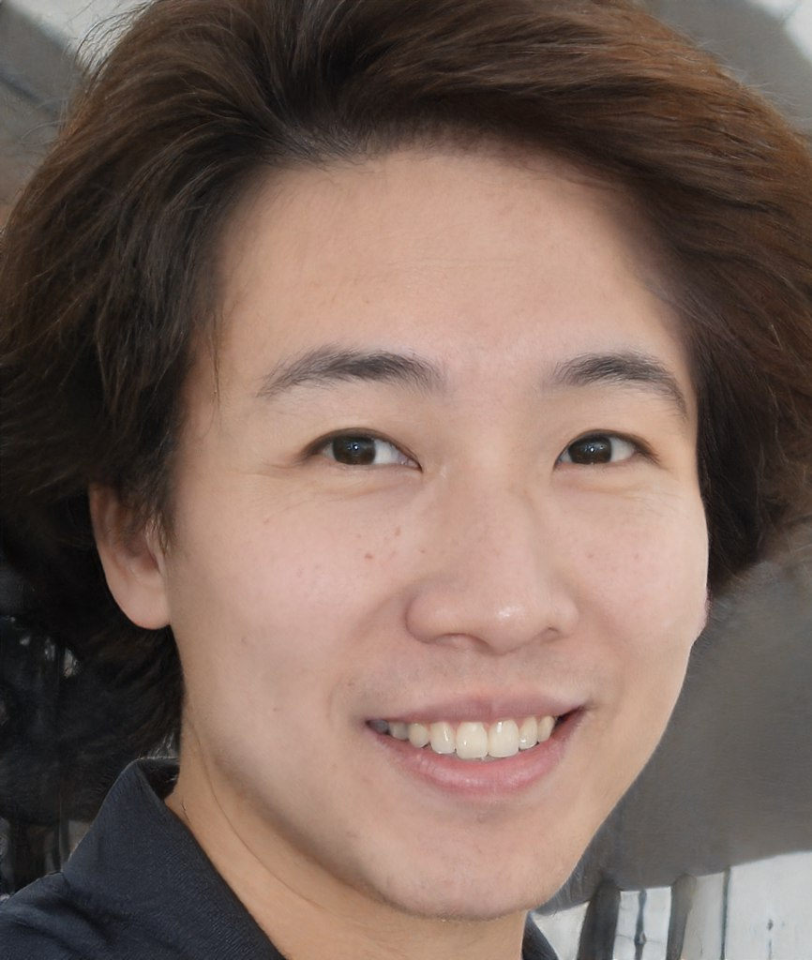
E
F
12
Elliot is an Engineer from England who works in a chemical factory. He notice an odd sensation on his eyes after returning from work. The closest hospital is two hours away, and he lives alone.
He was advised to use the Agarthea app to have a live consultation with a doctor. He described his symptoms, and it was determined that he only had pink eye. He was given a prescription by the doctor, and the medications came the following morning. Additionally, he scheduled a checkup follow-up appointment using Agarthea for a week later.
Felix is an independent Film Director. He enjoys teaching young people about filmmaking, so he creates filmmaking courses and posts them on Agarthea. He assists people with his course while also earning extra money by hosting a virtual group class for beginners.
G
H
Greta is a Government Official (Education Sector) in Germany. She is looking for ways to improve education in Germany by hiring a large number of professionals.
Greta uses Agarthea to find teachers from all over the world to teach at Germany. Many highly qualified professionals applied to be on-site and virtual teachers.
Huang is a Hairdresser from Hong Kong. In addition to his hectic schedule, he enjoys going hiking every weekend. He frequently hikes alone, although he often feels lonely and wishes he had buddies with him.
He searches for hiking groups on Agarthea and joins them for hikes.

Slide 35
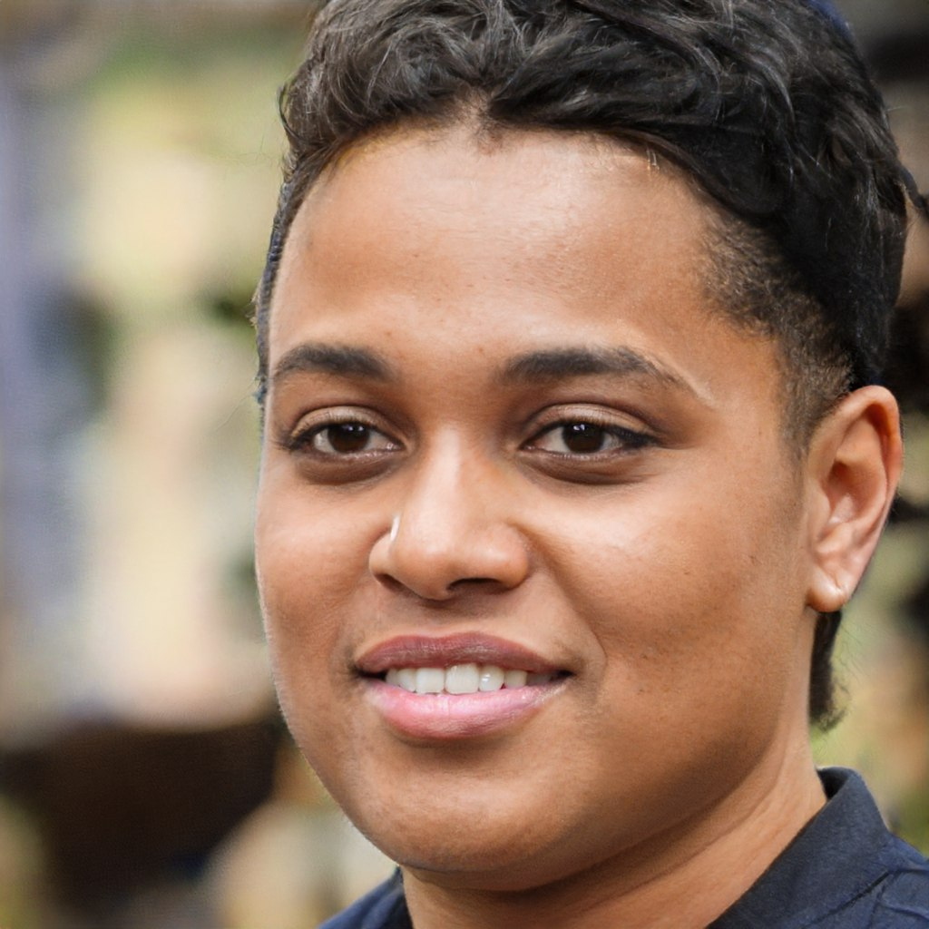
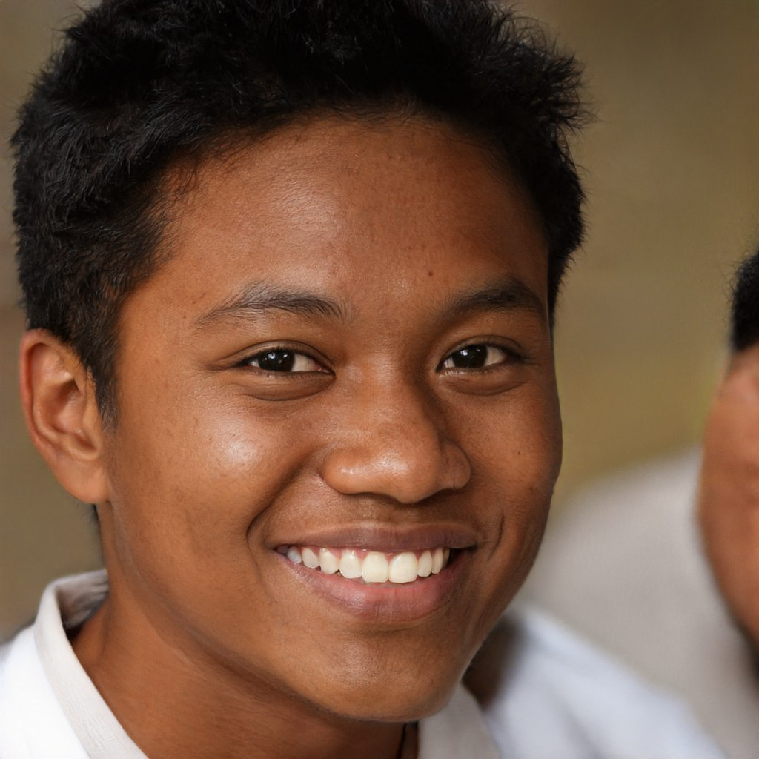
I
J
12
Igor is an Ice skating athlete from Iceland. He recently competed in China and needs to travel to France right away for a major tournament.
Igor has been using the Agarthea health app, which allowed him to download all of his medical records and send them to the event coordinator on time.
Jaden is a young Jamaican Journalist. She was recently accepted to a university in the Netherlands. She wants to relax when she arrives before the start of university, so she takes care of everything she needs before leaving.
She uses Agarthea to find student dorm, buy a bus pass, and pre-book taxi to pick her up in the airport.
K
L
Kimani is a proud transgender who works in Kenya as a Kitchen Assistant. He is currently looking for a new job, but it is difficult for a transgender person to find work in Kenya.
He discovered Agarthea and joined their partner program. He becomes a taxi-bike driver, and while doing so, he earns money not only from passengers, but also from simply using Agarthea.
Lae is a young entrepreneur from Laos who enjoys swimming. He owns a public pool and works as a Lifeguard there.
He utilizes Agarthea to rent out his swimming pool to the public in an effort to promote his business. People occasionally organize large events at his swimming pool because they appreciate his services so much.

Slide 36
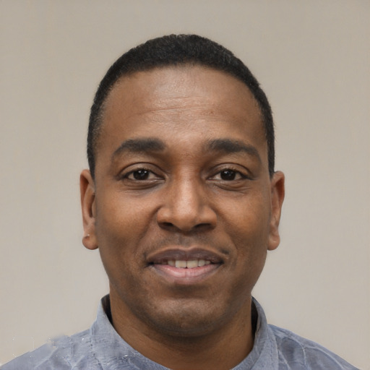
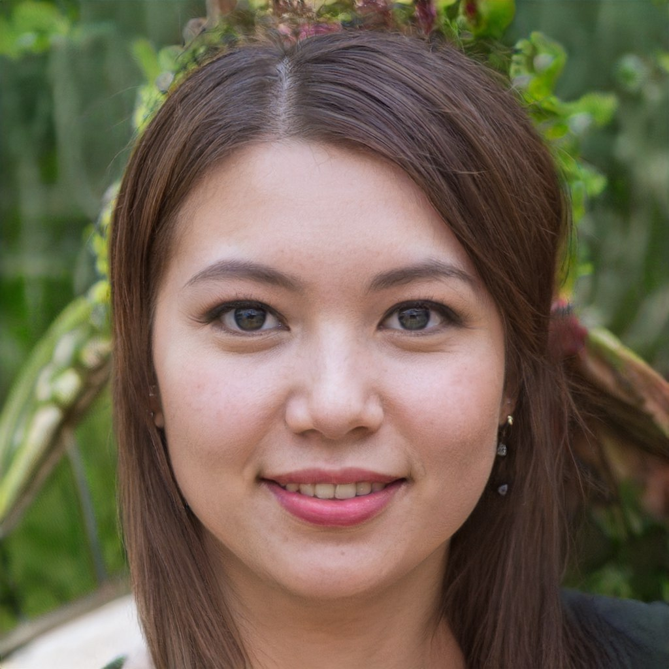
M
N
12
Mohammed is a Moroccan Model. His career was going well until the pandemic struck. As a result, he is having difficulty finding work.
But thanks to Agarthea, he was able to make contact with a hiring manager. And he is now back in the modeling business.
Naaib is a Nurse from Nigeria. He recently just inherit a big house from his father. But the house is so big and he just living alone.
So he rent out some part of his house using Agarthea for long term only. He is currently have 5 housemates living together in the house.
O
P
Omaira works as an Operations Manager at an Oman fitness center. She is struggling with her job because she has to work almost every day overtime just to consolidate members' databases and send emails one by one to remind them that their membership is about to expire.
She was able to regain work-life balance after discovering Agarthea because people who signed up for her fitness center now receive an automatic alert and notification of their membership, so she no longer has to do it manually.
Patricia 16yo from Phillipines, he's from a low-middle income status family wants to study Personal Trainer accounting in Australia.
He’s looking for scholarship for A-level in Agarthea to help him funds his study and he sees a wide range of universities he can apply for.

Slide 37
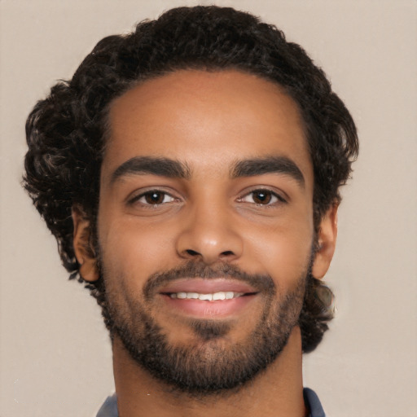
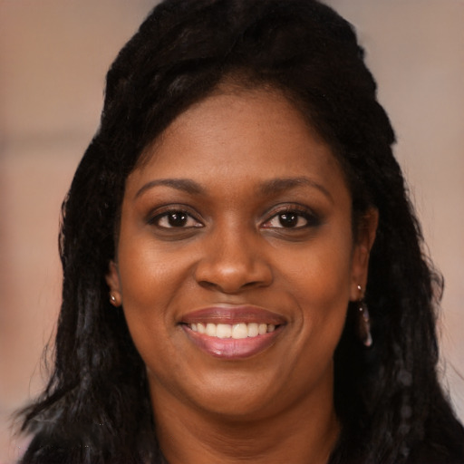
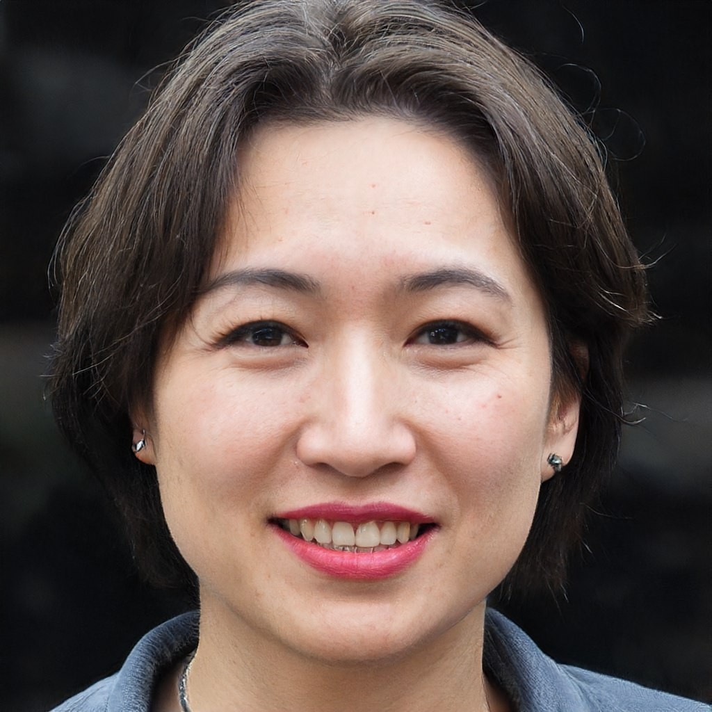
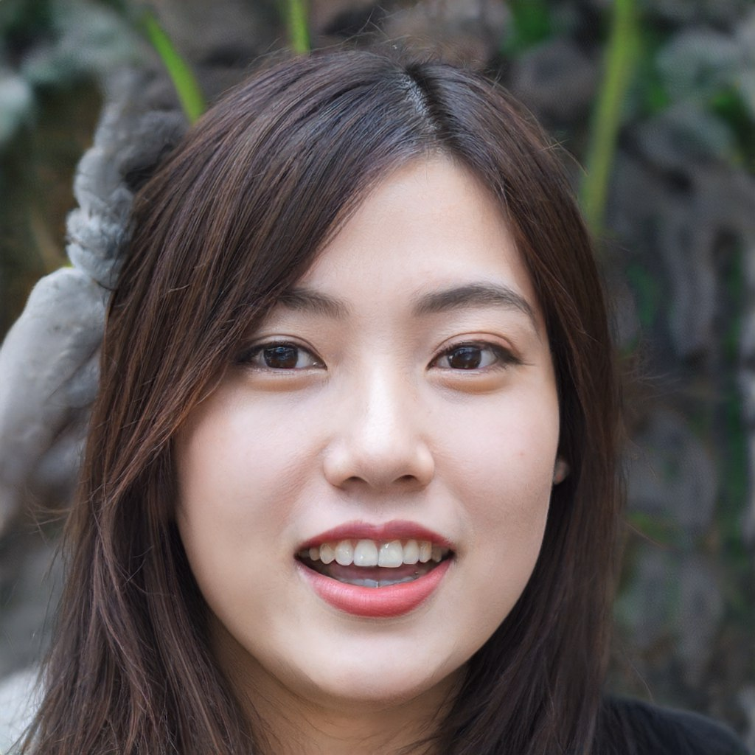
Q
R
12
Qaabil 16yo from Qatar, he's from a low-middle income status family wants to study Quality Manager accounting in Australia.
He’s looking for scholarship for A-level in Agarthea to help him funds his study and he sees a wide range of universities he can apply for.
Rene 16yo from Rwanda, he's from a low-middle income status family wants to study Recruiter accounting in Australia.
He’s looking for scholarship for A-level in Agarthea to help him funds his study and he sees a wide range of universities he can apply for.
S
T
Soo Young 16yo from South Korea, he's from a low-middle income status family wants to study Sales Associate accounting in Australia.
He’s looking for scholarship for A-level in Agarthea to help him funds his study and he sees a wide range of universities he can apply for.
Thinnakorn 16yo from Thailand, he's from a low-middle income status family wants to study Teacher accounting in Australia.
He’s looking for scholarship for A-level in Agarthea to help him funds his study and he sees a wide range of universities he can apply for.

Slide 38
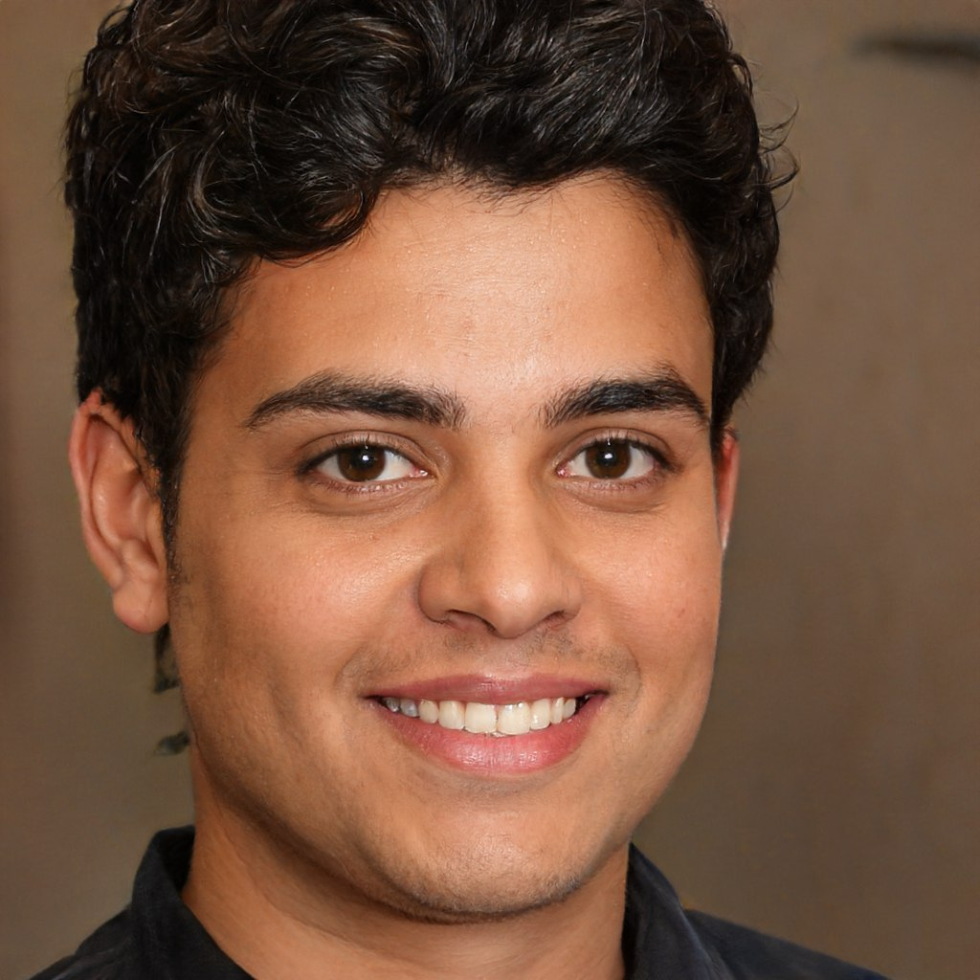
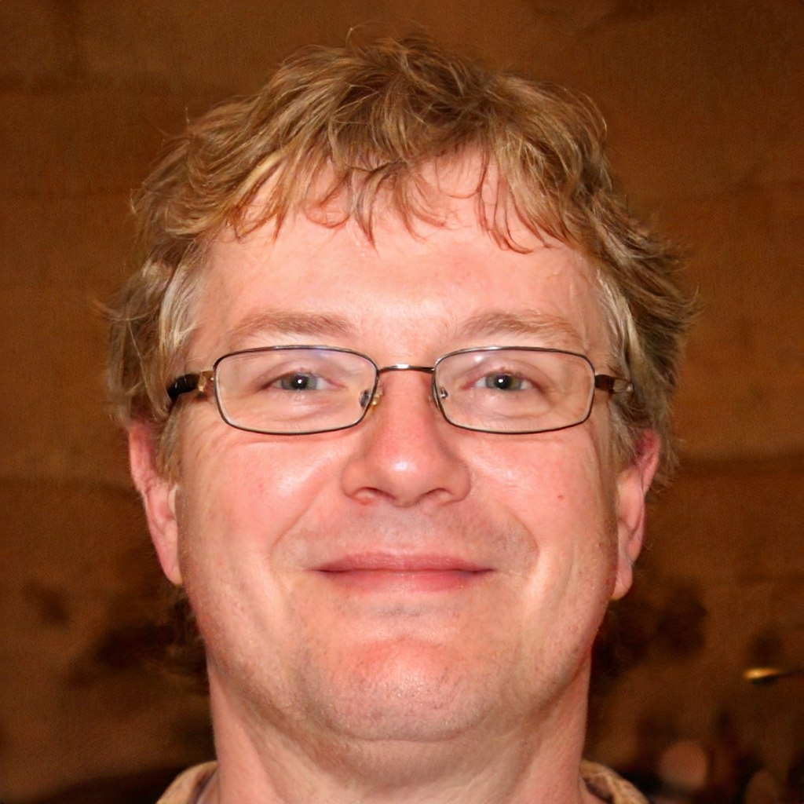
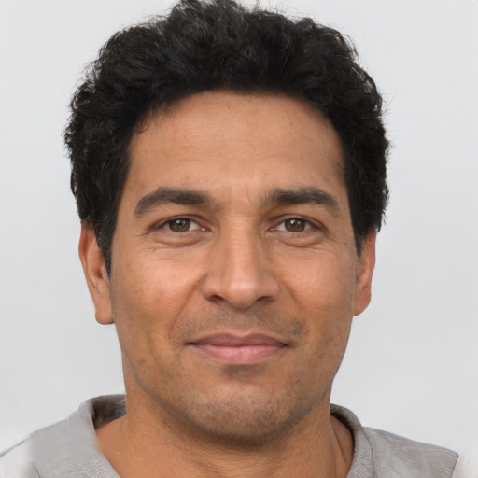
U
V
12
Uliana 16yo from Ukraine, he's from a low-middle income status family wants to study University accounting in Australia.
He’s looking for scholarship for A-level in Agarthea to help him funds his study and he sees a wide range of universities he can apply for.
Victor 16yo from Vanezuela, he's from a low-middle income status family wants to study Violin accounting in Australia.
He’s looking for scholarship for A-level in Agarthea to help him funds his study and he sees a wide range of universities he can apply for.
W
X
Wesley 16yo from Württemberg, he's from a low-middle income status family wants to study Wedding Coordinator accounting in Australia.
He’s looking for scholarship for A-level in Agarthea to help him funds his study and he sees a wide range of universities he can apply for.
Xavier 16yo from Mexico, he's from a low-middle income status family wants to study X-Ray Developer accounting in Australia.
He’s looking for scholarship for A-level in Agarthea to help him funds his study and he sees a wide range of universities he can apply for.

Slide 39
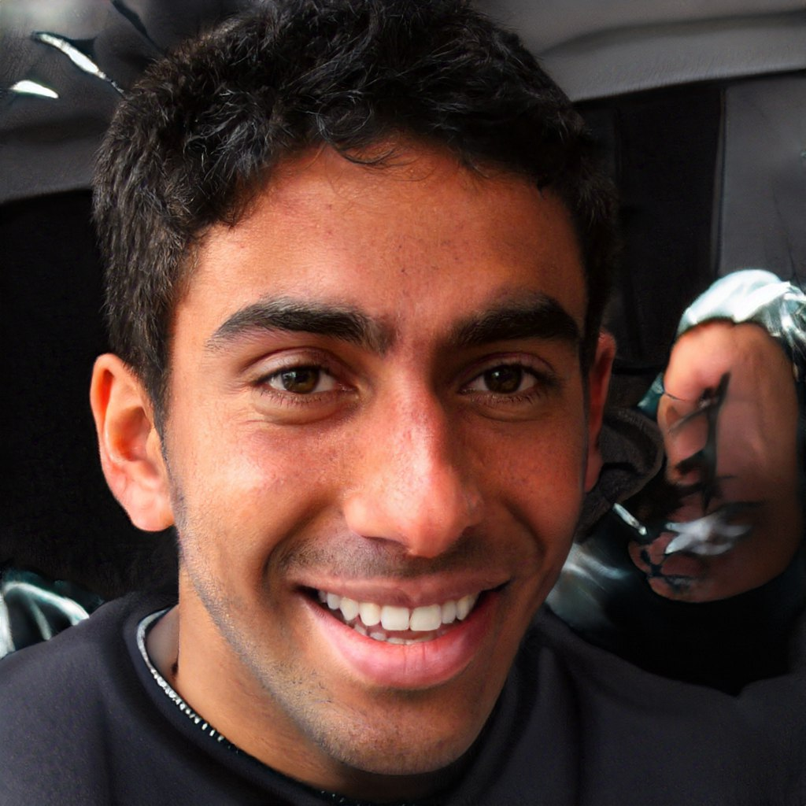
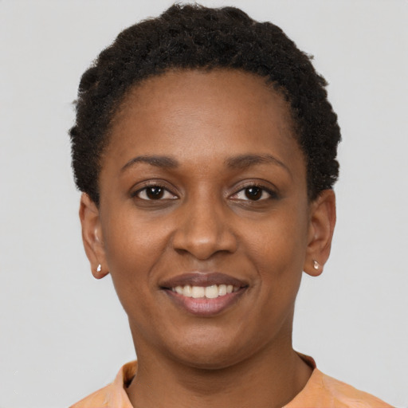
Y
Z
12
Yusuf 16yo from Yemen, he's from a low-middle income status family wants to study Yoga Instructure accounting in Australia.
He’s looking for scholarship for A-level in Agarthea to help him funds his study and he sees a wide range of universities he can apply for.
Zarira 16yo from Zimbabwe, he's from a low-middle income status family wants to study Zoo Veterinarian accounting in Australia.
He’s looking for scholarship for A-level in Agarthea to help him funds his study and he sees a wide range of universities he can apply for.
Agarthea is a nonprofit DAO, meaning ALL profits made will be placed back into Agarthea and/or Agartheum Eco-Systems focusing on funding students who lack the financial means. This includes all or some of the following; Funding, Tuition Fees, Travel, Visas, Food, Activities, Equipment,

Slide 40
Product
Mobile ver
*early concept. Subject to change anytime
13
Connect to Web3 Wallet
Mobile Home
University Dashboard
Search University

Slide 41
Product
Tablet ver
*early concept. Subject to change anytime
13

Slide 42
Product
Web ver
*early concept. Subject to change anytime
13

Slide 43
Partnerships
14

Slide 44
Agartheum
Tokenomic
14
Foundation
Insider
Project Development : 5%
Development Tax : 2%
Founder : 1%
Treasury : 4%
Community
Charity Tax : 8%
Public Sale
Presale : 78%
Liquidity Tax : 2%

Slide 45
Market Cap
Target
15
Xxxx
Xxxx
High school students
College Students
Teachers & Professors
Job Seeker
Libraries
People bla bla bla
Population bla bla bla
Employers/
Corporate
Gamers
Content Creators
Travelers
Artists & Talent
Athletes & Active People
Vehicle
Owners
Property Owners
Nerds, Geeks, and Geniuses
Health Workers & Patients

Slide 46
Investor Relations
16
Platinum
Gold
Diamond

Slide 47
Agarthea Roadmap
MILESTONE TITLE
MILESTONE TITLE
Milestone description
Milestone description
2023
Q1
Q2
Q3
Q4
MILESTONE TITLE
MILESTONE TITLE
2024
Milestone description
Milestone description
MILESTONE TITLE
MILESTONE TITLE
Milestone description
Milestone description
Q4
Q3
Q2
Q1
2023-2025
3 Years Plan
2025
MILESTONE TITLE
MILESTONE TITLE
Milestone description
Milestone description
MILESTONE TITLE
MILESTONE TITLE
Milestone description
Milestone description
Q1
Q2
Q3
Q4
2026
MILESTONE TITLE
MILESTONE TITLE
Milestone description
Milestone description

Slide 48
Conclusions
18
Recruitment Consultancy
Travel & Transportation
Crypto Investors
Visa
DAO
Businesses
Venture Capital
Interoperability
Investors
Sidechain(s)
Content Creators & Talents
Multichain(s)
Students
Grants
Agarthea App
Agartheum
Universities
Sponsorships
Tokenomics
Healthcare
Donations
Governments
Smart Contracts
Accommodation
Liquidity Pool
Metaverse
Validators
Activities
Rewards
E-Wallet
E-Learning & E-Library
Crypto Traders
E-Gaming & E-Sports

Slide 49
“Education is the passport to the future. For tomorrow belongs to those who prepare for it today”
- Malcolm X-

Slide 50
Q&A

